Slide 1
Masters Thesis Design and Development of Software Agents for Location Privacy-risk estimation
Shashank Sharma, M. Sc. Zohaib Riaz, Prof. Dr. Kurt Rothermel
Institute of Parallel and Distributed Systems (IPVS)
07-12-2018

Slide 2






Background & Motivation (1)
Location Based Applications (LBAs) on smartphones uses location information:
Share an event or activity with family & friends
Path recommendations, traffic information
Nearby POIs
Monitor outdoor sport activity
April 2018:Google Maps used by154.4 Million users.

Slide 3

Background & Motivation (1)
LBAs can reveal
Illnesses, political and religious inclinations, etc.
Personality traits, habits
Favorite restaurant, club/gym
When collected for longer durations, it can reveal daily routines
Knowing home/work/play locations
Knowing exact hour of transitions between them
Hypothesis: Sharing location imposes privacy risk
91% of the Americans have lost control on their private data.
Only 9% users are confident that the social media will protect their private data.
Notes:
After this slide: say that currently there exists no solution for the LBA users to detect this privacy risk.

Slide 4



Contributions
Design and development of a Privacy-Risk-Estimator (PRE) application
Assumption: Location sharing decision is manual
Carl
(lat, lon)
LBA App
PRE App
Develop a location prediction model and privacy-risk estimation
Detect stay-points and form states from raw location coordinates
Evaluate algorithm on Microsoft Geolife dataset
Implement PRE app for privacy-risk estimation
1
2
3
4

Slide 5
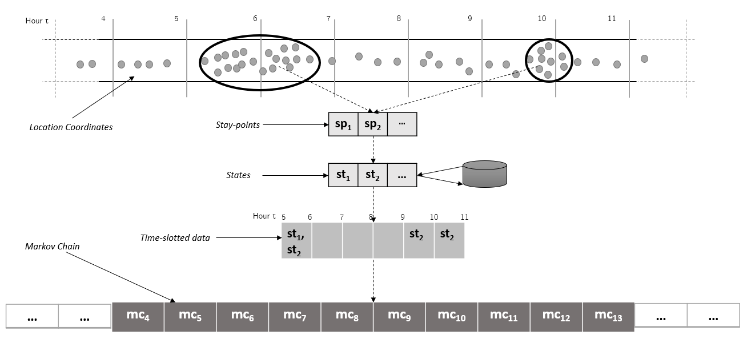
Basic Definitions
2
1

Slide 6
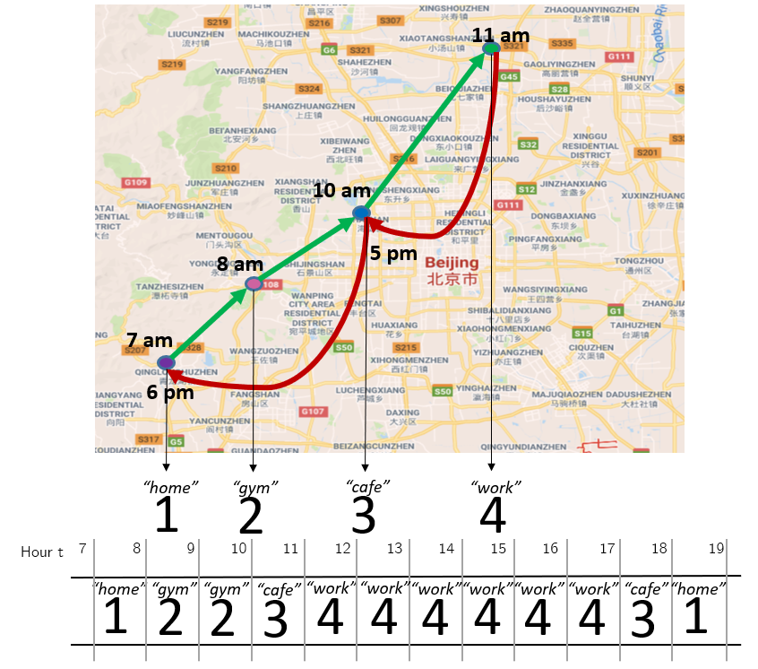
Prediction Model: Markov Chain
1
Markov Chain is built on states
States st = {st₁, st₂, …st_{n}} : Home, gym, work, supermarket, etc.
Markov Chain with 2 States
p₁₁
p₁₂
p₂₂
st₁
st₂
p₂₁
Markov Chain example at discrete time-slots on a map

Slide 7
Building Markov Chain Step 1: Time-slotted Data
1
A. Calculate State Weights w = {w₁, w_{2, …} w_{k}}
Hour t
4 5 6 7 8 9 10 11
st₁
st₂
st₃
w = {1, 0, 0}
w = {0.17, 0.58, 0}
B. Normalize State Weights
Hour t
4 5 6 7 8 9 10 11
st₁
st₂
st₃
w = {1, 0, 0}
w = {0.23, 0.77, 0}

Slide 8
Building Markov Chain Step 2: Transition Matrices
1
Transition Matrix trn_mat records transition from one time-slot to the next
t
st₁ st₂
w₁
w₂
w₁*w₁ | w₁*w₂
w₂*w₁ | w₂*w₂
trn_mat_{t} = w^{t-1T}.w^{t} =
*
w₁ w₂
=
st₁ st₂
Transition Matrix trn_mat is:
- Aggregated over the days
- Normalized to calculate the probability for transition from state i to state j
t
st₁ st₂
p₁₁ | p₁₂
p₂₁ | p₂₂
mc_{t} = Normalize[ (day 1)trn_mat_{t} + (day 2)trn_mat_{t} + …. ] =
st₁ st₂
p₁₁
p₂₂
p₁₂
st₁
st₂
p₂₁

Slide 9
Privacy-risk Estimation (1)
1
Markov Chain Model is used for privacy-risk estimation
If user‘s current location is state st_{i} at time-slot t:
Confidence of being at state st_{j} in time-slot t+1 is calculated as (p_{ii}*p_{ij})
The future locations are predicted based on current location and current time-slot, until the confidence drops below a threshold
t t+1 t+i t+n t+n+1
Start
1
i
n
End
Current Location
Next Predicted Location
ith Predicted Location
End of Prediction
Predicted Path
Path 1
work
work
cafe
home
Path 2
supermarket
home

Slide 10
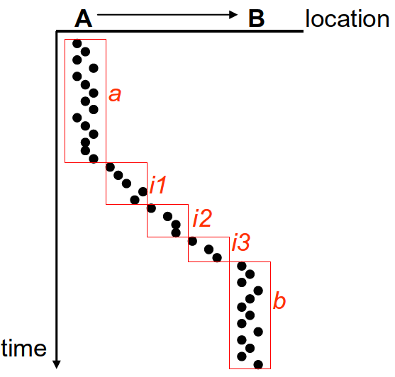
Stay-points Detection (1)
2
Stay-points sp = {sp_{1,} sp₂, … sp_{n}} are the locations where the user spent ample time
Time and distance based clustering works based on a distance threshold d_th and time threshold t_th
Clusters a and b are detected as stay-points & i1, i2, i3 are rejected as noise
Time and Distance based Clustering

Slide 11
Stay-points Detection (2)
2
Sporadic GPS Trajectories
4 5 6 7 8 9 10 11
End of trj 1
x Kms
t hours
Start of trj 2
Stay-points as start and end points of trajectories:
s = x/t kms/hours
If s = 0 then,
End of trj1 and start of trj2 is same location.
Else,
Estimate the departure from trj1 & arrival at trj2 based on s

Slide 12
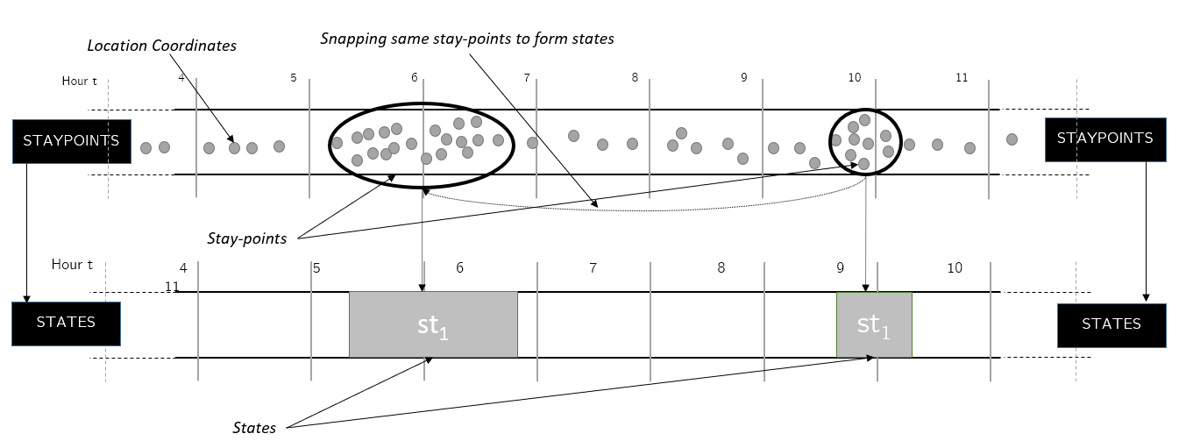
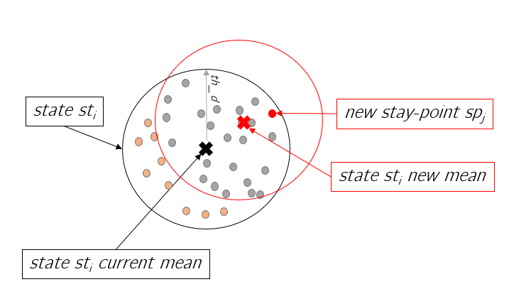
Forming States
2
Stay-points which are geographically close-by are snapped to same state
sp = {sp_{1,} sp₂, … sp_{n}} to st = {st₁, st₂, …st_{k}} where k <= n
Drifting Problem

Slide 13
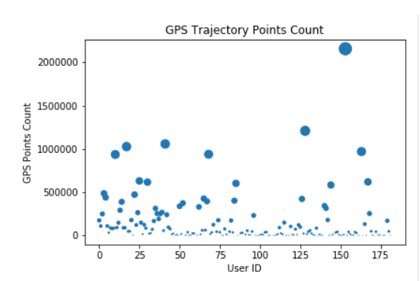
Dataset & its Analysis (1)
3
182 users’ GPS trajectory data for the period of five years

Slide 14
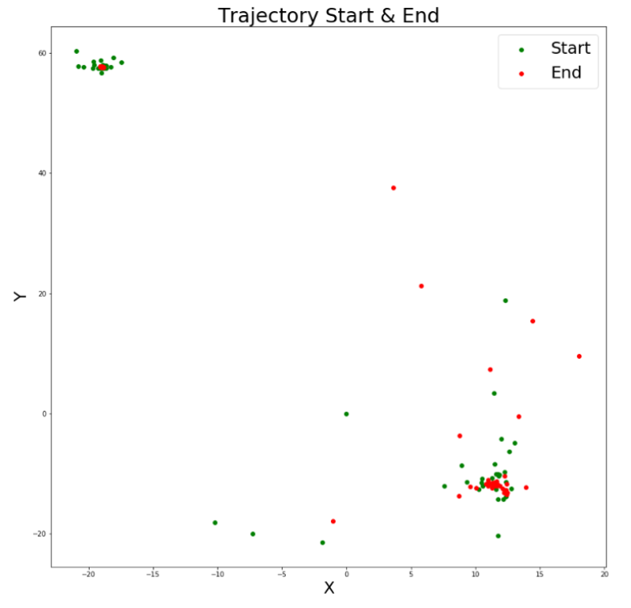
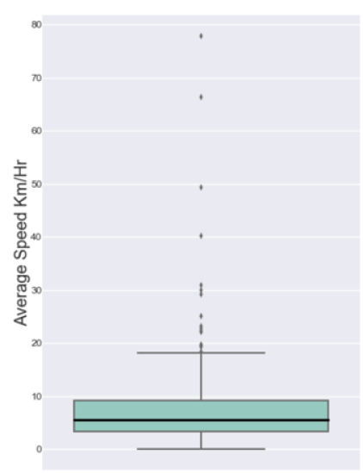
Dataset & its Analysis(2)
3
Speed of trajectories
Trajectory data analysis

Slide 15
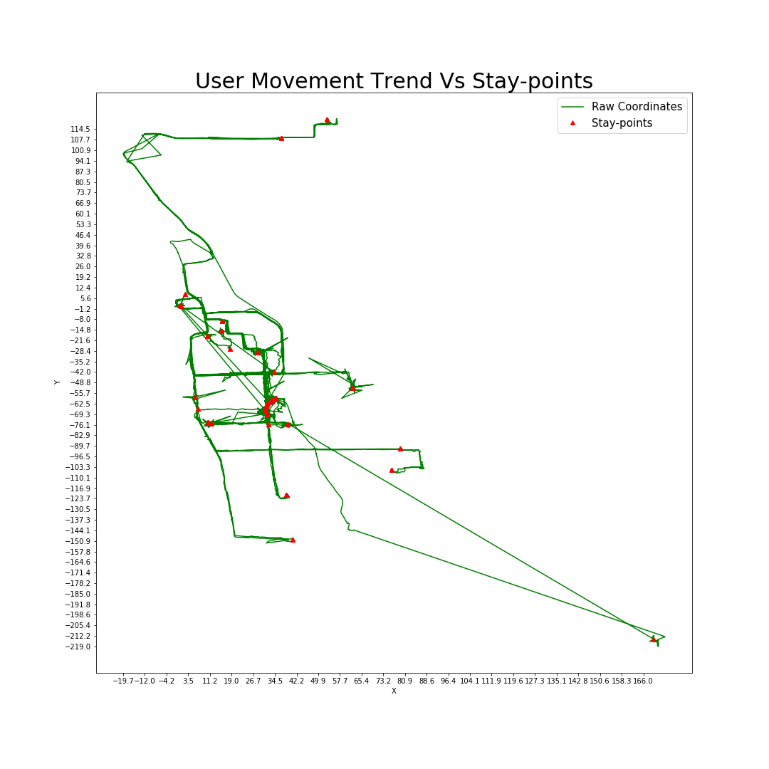
Stay-point Detection Results
3

Slide 16
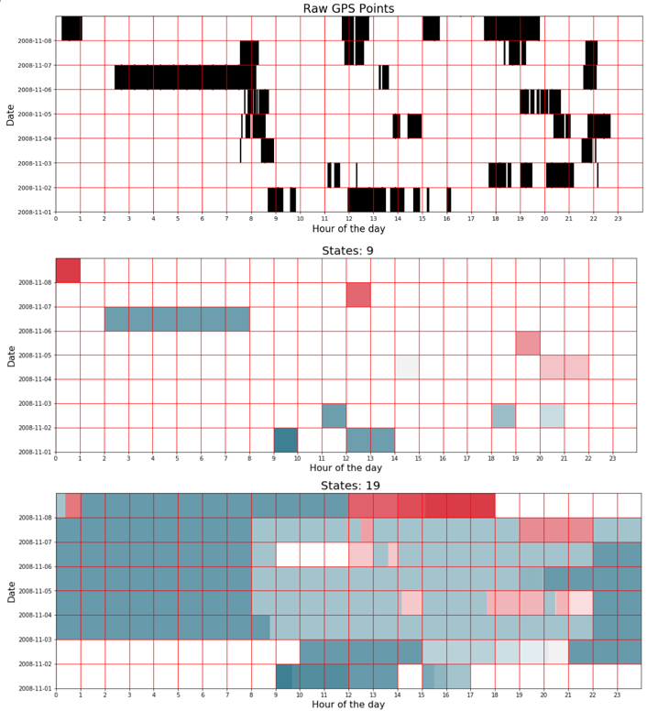
Time-slotted Data Result
3

Slide 17
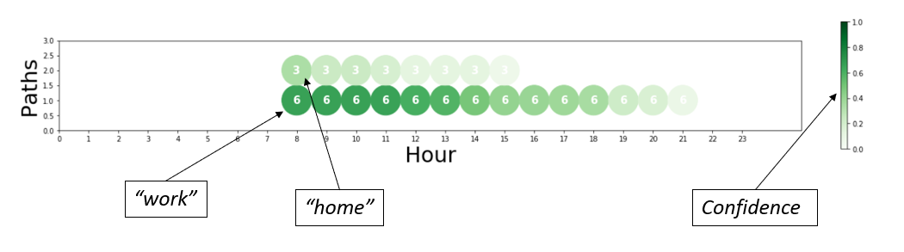
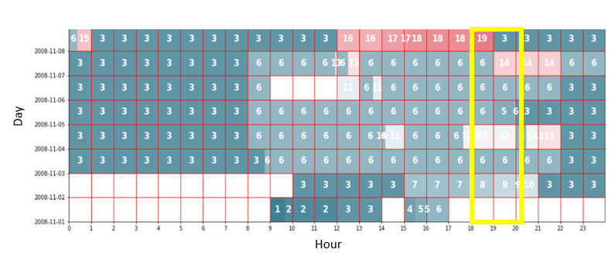
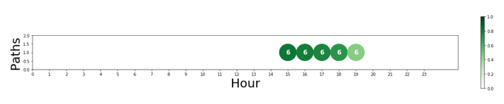
Privacy-risk Estimation
3
Path Prediction
Markov Chain
Considering each & every transition
Path Predicted
Terminates at hour 19
Hypothesis: Markov Chain need to forget infrequent transitions as well

Slide 18
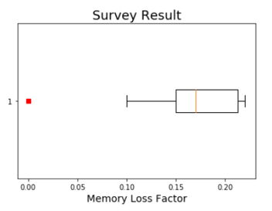
Proposition: Calibration of Privacy-risk Estimation
3
Introducing Memory-loss Factor
Memory-loss factor mlf is applied to prediction model
mlf = 0.05
A
P =
0.79 0.12 0.03 0.03 0.03
B
newP =
0.74 0.07 0 0 0
C
normP =
0.91 0.09 0 0 0
Survey Result for Memory-loss Factor
“How long will the user stay at location “Work” if he was observed at location “Work” at x
hour.”
The survey had 10 participants
Each participant sees the time-slotted data for 1 minute and above question is asked
X in the question was replaced based on the data presented
Memory-loss factor calculated is 0.17

Slide 19
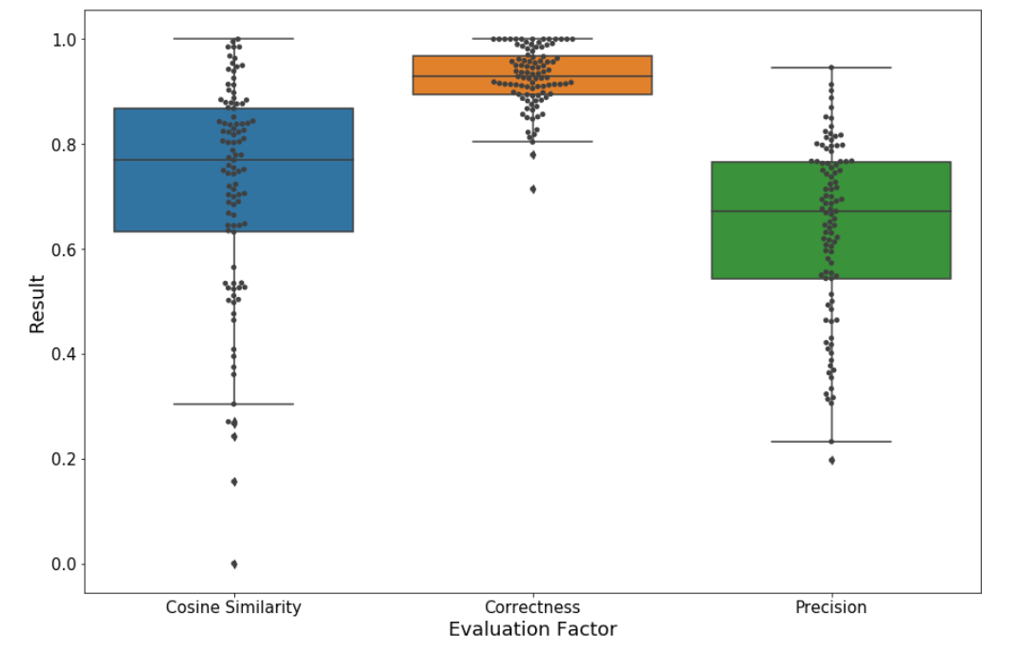
Prediction Evaluation
3
Metric:
Cosine Similarity -
C = (P.GT )/(||P||||GT||)
Accuracy Correctness
Ac = Pc/Pt
Accuracy Preciseness
Ap = 1 − |P − GT|/2

Slide 20
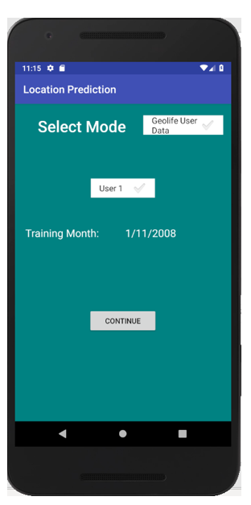
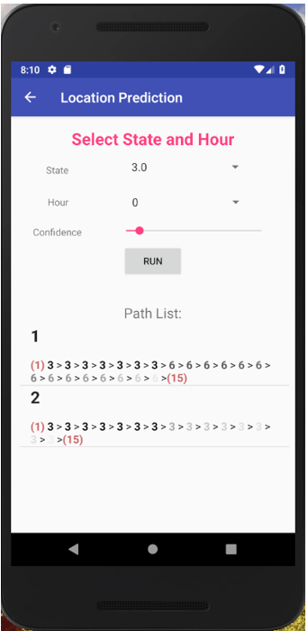
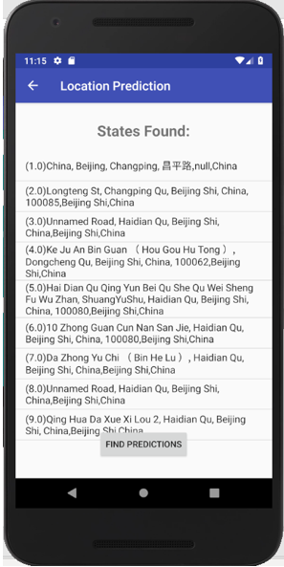
PRE Android Application
4

Slide 21
Conclusion
The Location-Based Applications (LBAs) collects location data
Based on this, user’s whereabouts can be easily guessed- imposing privacy risk
Proposed Markov Chain Prediction Model for smartphones:
Tested Prediction outputs with real-life dataset (Geolife dataset)
Implemented PRE Android application for privacy-risk estimation for smartphone users
Future work
Increase features for prediction model
User interface improvements for PRE Android application

Slide 22
Your Thoughts?

